Slide 1
Accel Mouse
Robotics Project
P. Ahrendt, C. Siman-Chereches, S. Chenyu

Slide 2
Table of Contents
Introduction
The initial idea
Architecture
Implementation
Challenges
Prerequisite Libraries
The Final Design
Conclusion

Slide 3
Introduction
Build a robotic application
Use sensors to estimate position or attitude of object
Our phones have the common sensors most robots use:
Accelerometer
Gyrometer
Magnetometer

Slide 4
The first try
Use the mouse on a flat surface, similar to how one would use a regular mouse
Assumption:
Use our sensors to estimate delta x & y (change in position)
Gyrometer and magnetometer don’t help for this
So only Accelerometer is left
Problem: sensor fusion is impossible, so no way to reduce noise
Distance can be computed by double integration of acceleration
Problem: due to noise there is a drift over time between the actual and estimated velocity
Integrating the drifted velocity to get the position increases the drift exponentially

Slide 5
Architecture

Slide 6

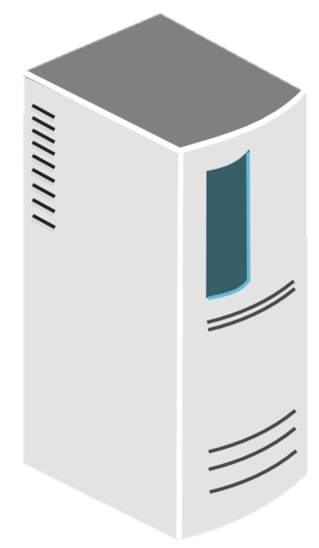
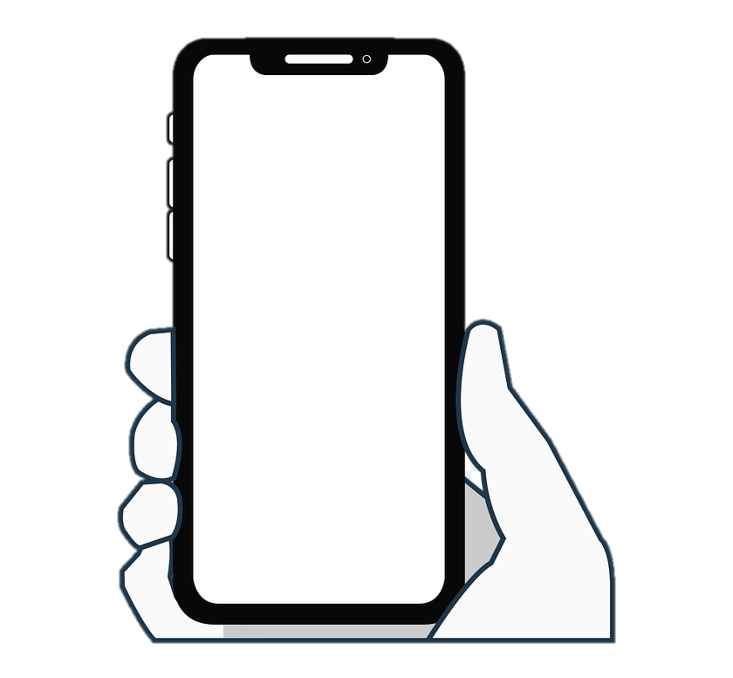
Architecture
Mouse gets moved on the monitor
Send calculated mouse position, clicks
and key press events
1
Send estimated angle and other events
3
Receive and process data further
Measure inertia with internal sensors
2

Slide 7
Architecture - Server
Handles the incoming data
Maps pitch and yaw attitude to pixels of display
Controls the mouse through a Python shell on MacOS and JavaScript shell on Windows
Applies a Kalmann filter (for 1D data) to the final displacement to reduce noise

Slide 8
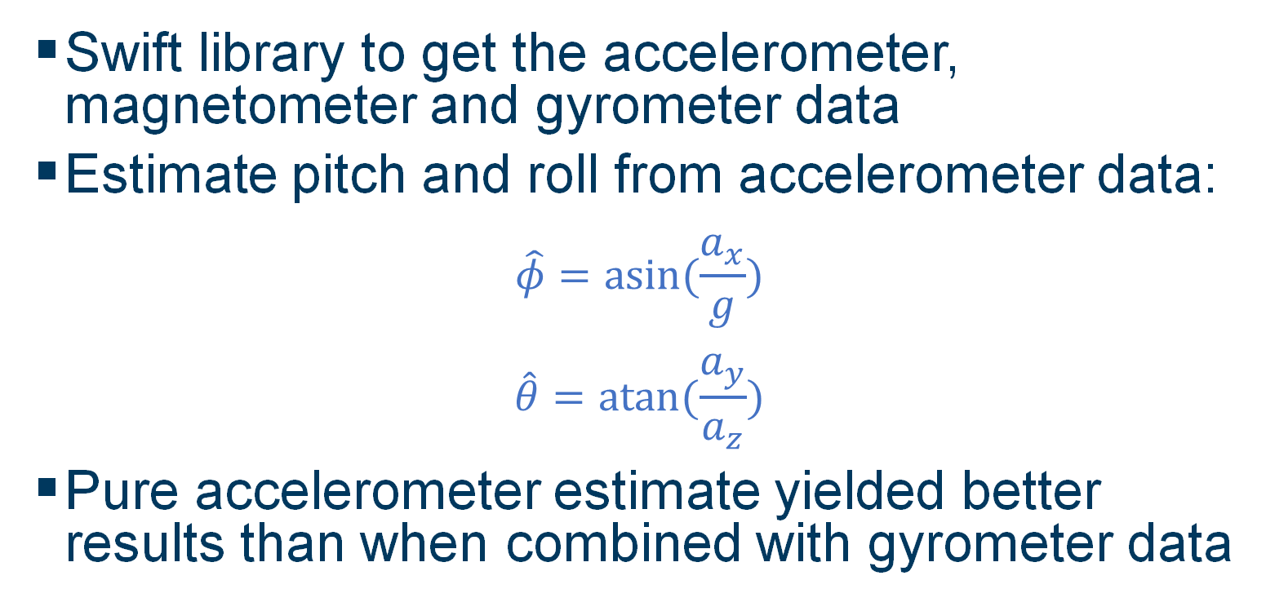
Architecture - Estimation of Euler angles
Swift library to get the accelerometer, magnetometer and gyrometer data
Estimate pitch and roll from accelerometer data:
$$\hat{φ}=asin⁡(\frac{a_{x}}{g})$$
$$\hat{θ}=atan⁡(\frac{a_{y}}{a_{z}})$$
Pure accelerometer estimate yielded better results than when combined with gyrometer data

Slide 9
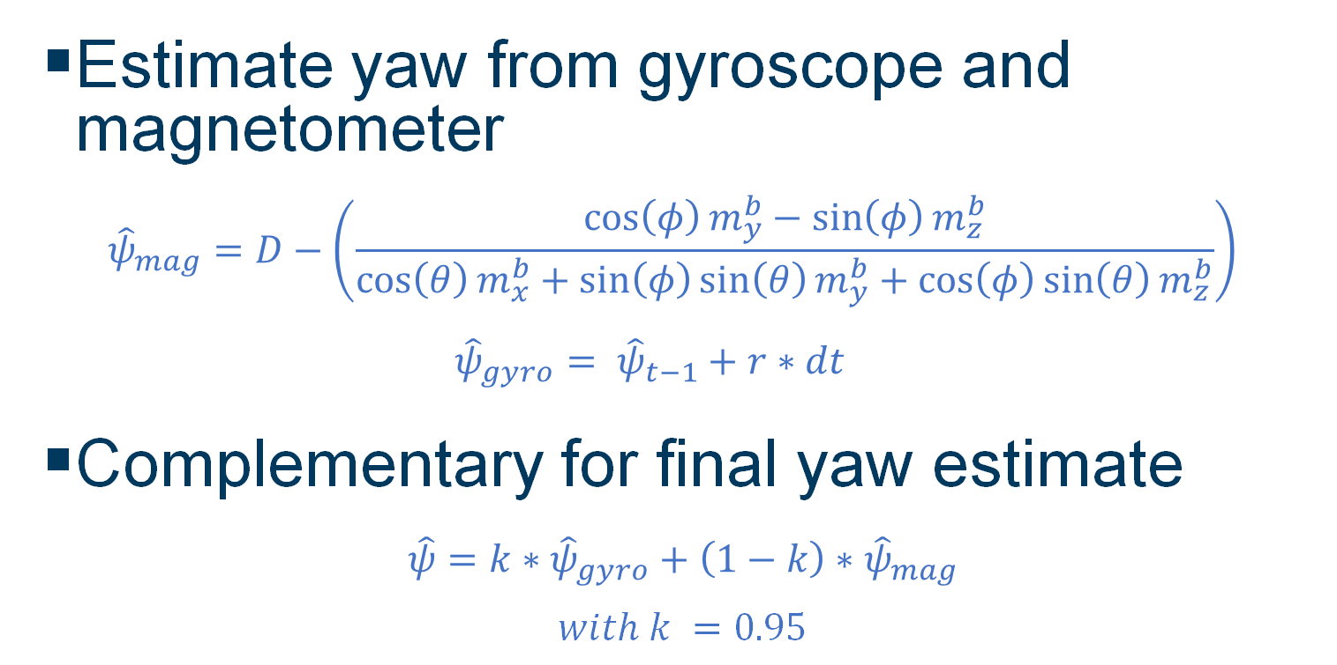
Architecture - Estimation of Euler angles
Estimate yaw from gyroscope and magnetometer
$${\hat{ψ}}_{mag}=D−\left(\frac{\cos\left(φ\right)m_{y}^{b}−\sin\left(φ\right)m_{z}^{b}}{\cos\left(θ\right)m_{x}^{b}+\sin\left(φ\right)\sin\left(θ\right)m_{y}^{b}+\cos\left(φ\right)sin\left(θ\right)m_{z}^{b}}\right)$$
$${\hat{ψ}}_{gyro}= {\hat{ψ}}_{t−1}+r∗dt$$
Complementary for final yaw estimate
$$\hat{ψ}=k∗{\hat{ψ}}_{gyro}+\left(1−k\right)∗{\hat{ψ}}_{mag}$$
$$with k =0.95$$

Slide 10
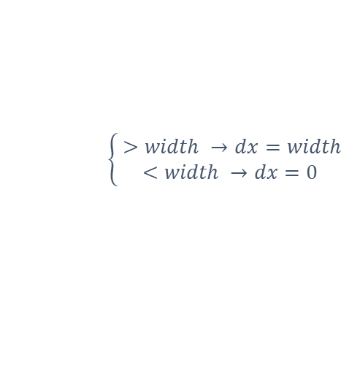
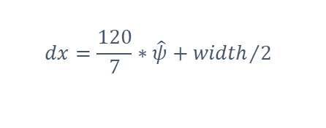


$$dx=\frac{120}{7}∗\hat{ψ}+{width}/2$$
$$\left\{\begin{aligned} >width →dx=width \\ <width →dx=0\end{aligned}\right.$$
$$dx$$
$$\hat{ψ}$$

Slide 11
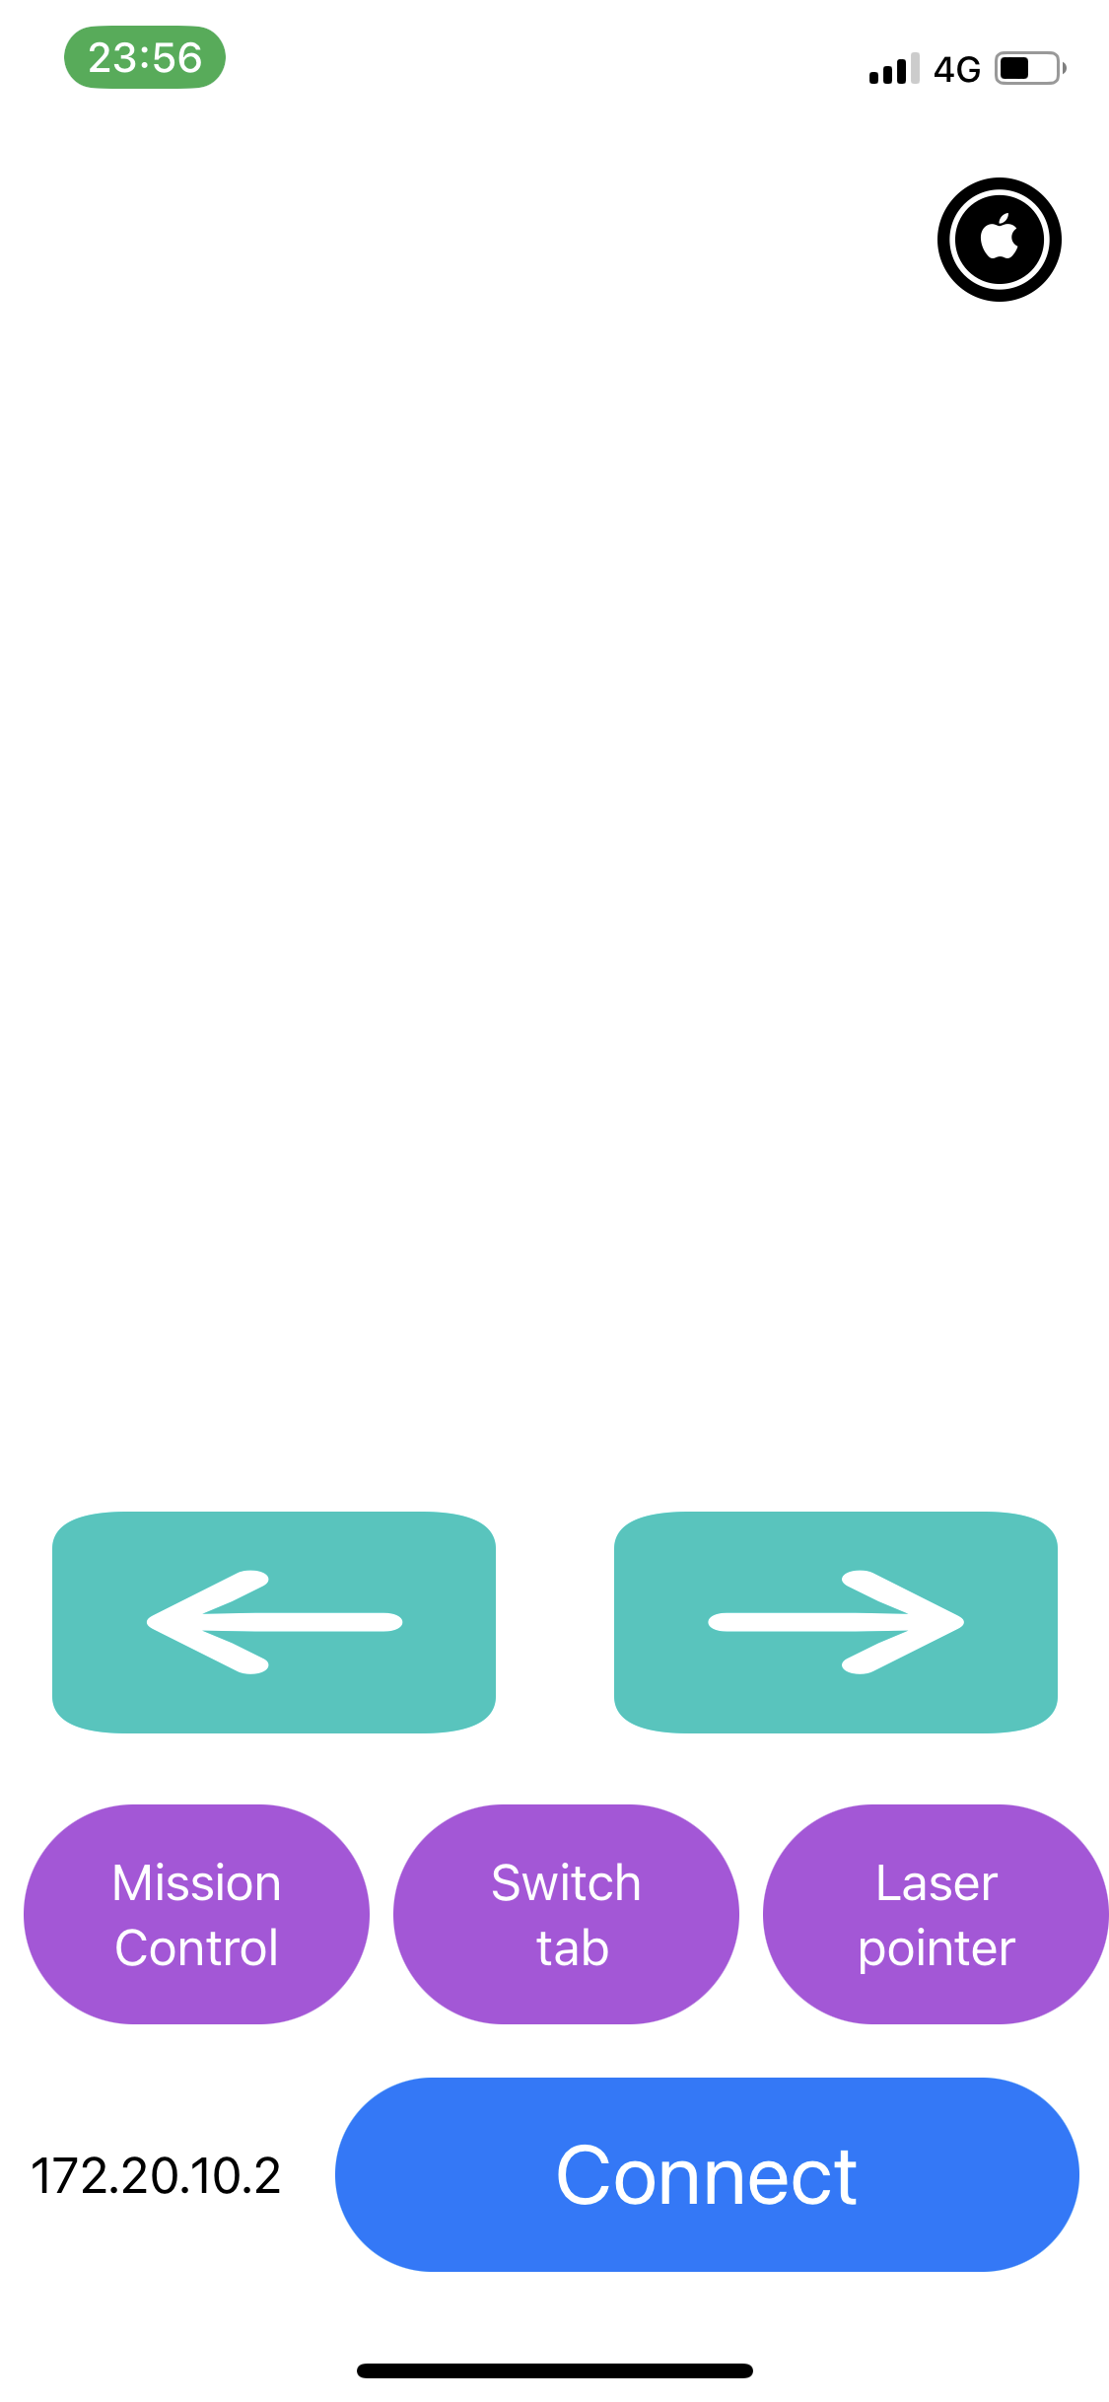

Slide 12
Code implementation

Slide 13
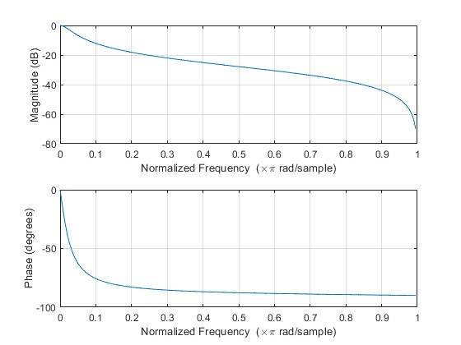
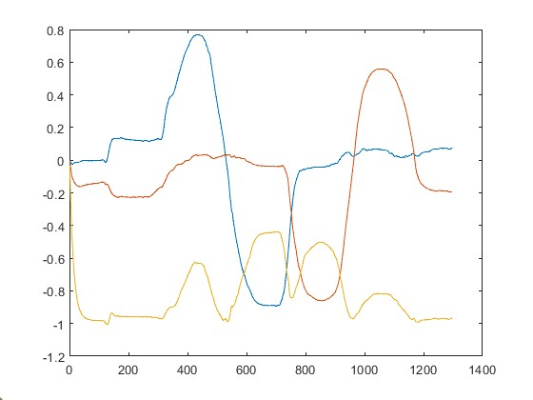
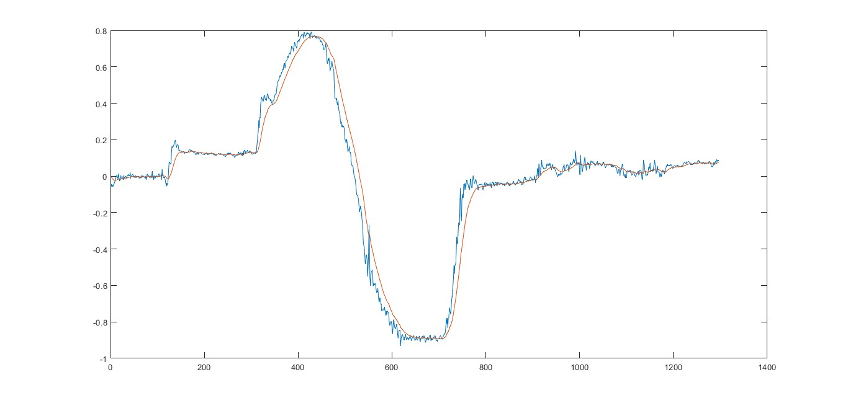

The IIR Filter
Objective: We need to filter the output noise of the accelerometer.
The filter we use: $y_{n}=\frac{\left(b_{1}∗x_{n}+b_{2}∗x_{n−1}−a_{2}∗y_{n−1}\right)}{a_{1}}$
The calculation of coefficients using MATLAB:
$a_{1}=1 a_{2}=−0.922 b_{1}=b_{2}=0.039$

Slide 14
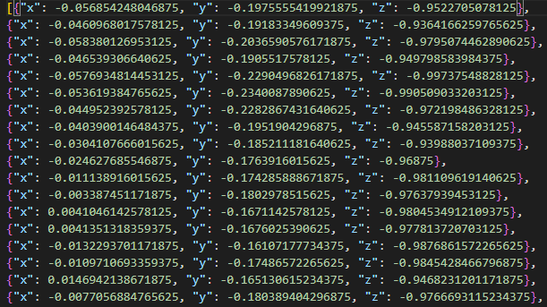
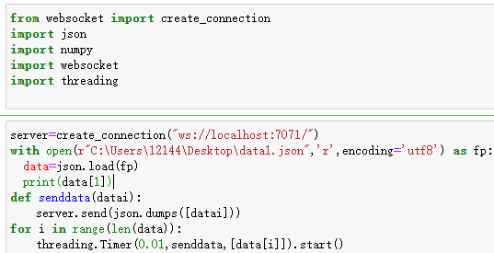
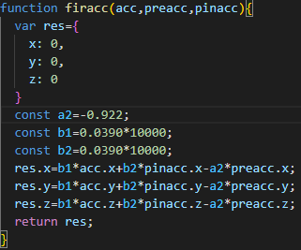
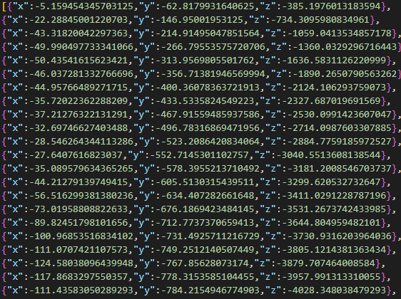
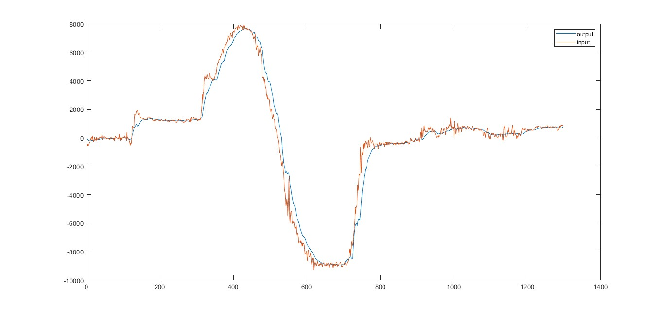
The IIR Filter
The code of the filter
data.json The data to send
sendtoserver.py sends data to server every ms
The IIR filter in the server serverreception.js
output.json the output result
the data.json and output.json in MATLAB

Slide 15
Challenges

Slide 16
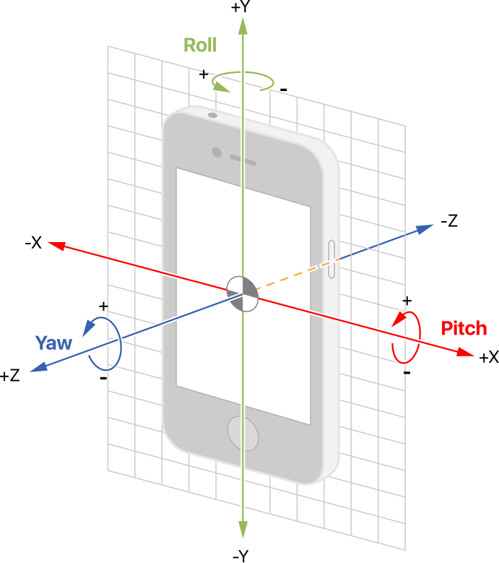
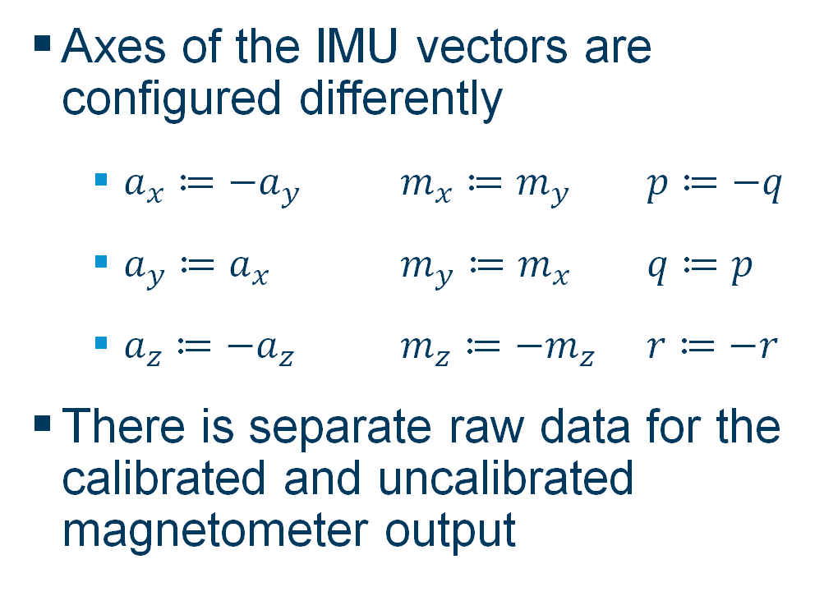
iPhone sensory data
Axes of the IMU vectors are configured differently
$a_{x}≔{−a}_{y}$ $m_{x}≔m_{y}$ $p≔−q$
$a_{y}≔a_{x}$ $m_{y}≔m_{x}$ $q≔p$
$a_{z}≔{−a}_{z}$ $m_{z}≔{−m}_{z}$ $r≔−r$
There is separate raw data for the calibrated and uncalibrated magnetometer output
4

Slide 17
Data transmission
Asynchronously sending data introduces problems:
Sometimes data is received in the wrong order
Differing packet number sent in a period
Sending data fast enough will throttle the received packets
A websocket allows for two-way low-latency communication
Other times, you just forget a hard-coded 3 second delay in your package sending script. Oops!

Slide 18
Magnetic North
The yaw angle is in the range [-π,π] but when you go above π, the angle resets to -π
This happens due to the position of the magnetic north and has to be accounted for in the yaw calculation
While testing the app, the environment was mostly not facing magnetic north, so the error case was difficult to notice
The solution was to add/subtract 2π each time the angle was switching

Slide 19
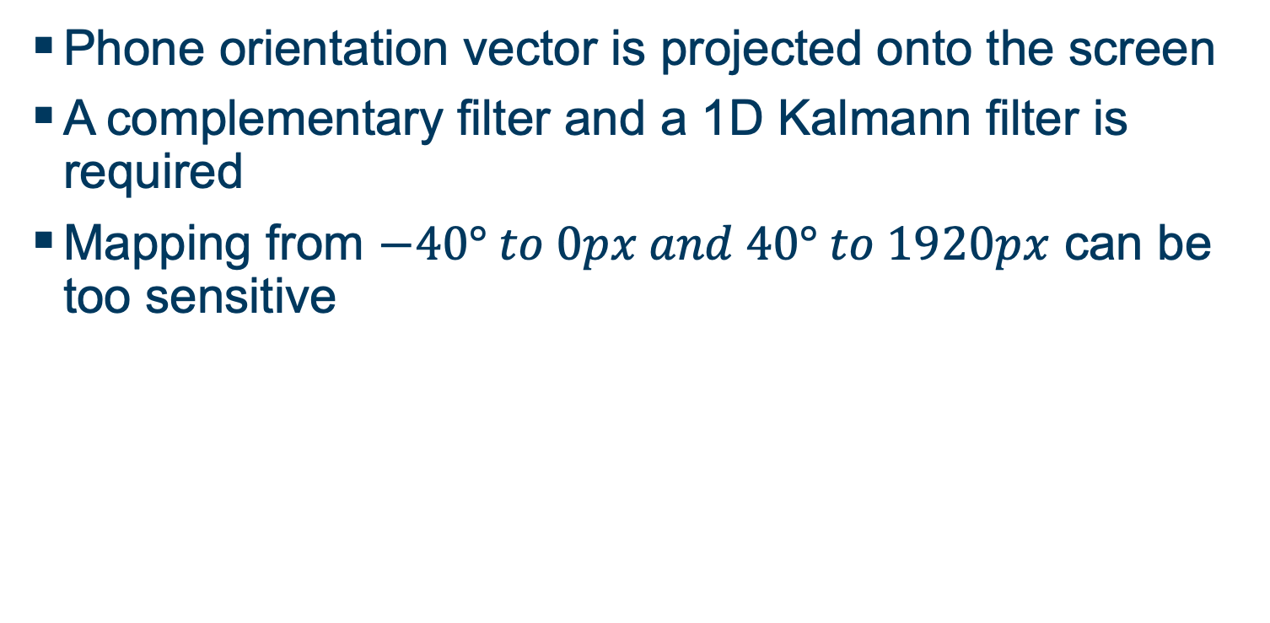
Noisy or unreliable projection
Phone orientation vector is projected onto the screen
A complementary filter and a 1D Kalmann filter is required
Mapping from $−40° to 0px and 40° to 1920px$ can be too sensitive

Slide 20
Prerequisite Libraries
General
Mathjs – math qol functions, better than native js
Websocket – for websocket communication
Kalmanjs – simple Kalman noise filter for 1D data
On MacOS
Pyautogui – mouse, keyboard events, screen info
On Windows
Node-cursor – for easier mouse driver access
VS 2019 and Windows C++ Dev. Kit – for accessing drivers
Robotjs – for sending keyboard events, reading screeninfo

Slide 21
Final Design
Switching windows, scrolling, and even presenting is possible with the phone
Data processing can happen on the server, or on the phone depending on demand
A usable, universally available mouse pointer

Slide 22
Conclusion
Phone attitude estimation using the in-built sensors can be used to control a cursor or possibly a robot
Using a complementary filter with the accelero-, magneto-, and gyro-meter yields a robust attitude estimation

Slide 23
Pointing at things with your phone is...
FUN

Slide 24
References
https://media.istockphoto.com/vectors/desktop-computer-icon-vector-isolated-vector-id942286504?k=20&m=942286504&s=170667a&w=0&h=faK8_FvtXDV0rGQh43k3SfCzFfBs7HgccQwWFw8j9Mg=
https://www.clipartmax.com/png/middle/277-2772015_iphone-clipart-smartphone-accessory-celular-sin-fondo-png.png
https://www.clipartmax.com/png/middle/4-42693_server-clip-art-server-clipart.png
https://docs-assets.developer.apple.com/published/1c3e1a60a4/10421a93-a1dd-41a8-a9c0-7147d3f47f27.png
https://github.com/callmechristian/mouse-server
https://github.com/phiahr/accel_mouse
Robotics Lecture

Slide 25
Thank you!
Questions?

